Slide 1

AI for Climate Action: Predicting CO₂ Emissions
Leveraging Machine Learning to achieve UN Sustainable Development Goal 13.

Slide 2
THE CHALLENGE
Predicting Emissions for a Sustainable Future
Addressing climate change requires data-driven strategies. Our project focuses on UN SDG 13: Climate Action, by developing a machine learning model to predict CO₂ emissions. This empowers policymakers with insights to mitigate environmental impact and foster sustainable development.
Why This Matters
Our Solution
CO₂ is a primary driver of global warming.
Utilize historical data to forecast future emissions.
Accurate predictions enable targeted policy interventions.
Identify key drivers of CO₂ output.
Supports global efforts for a cleaner, healthier planet.
Provide actionable intelligence for climate policy.

Slide 3
OUR APPROACH
Leveraging Supervised Learning
We employ supervised learning, specifically Linear Regression, to model the relationship between economic, demographic, and energy consumption factors and CO₂ emissions. This approach allows us to make quantitative predictions.
1
Data Collection & Preprocessing
Gathering comprehensive historical CO₂, GDP, population, and energy use data from sources like the World Bank. Data is cleaned, and features are engineered (e.g., GDP per capita).
2
Model Training
Applying Linear Regression to learn patterns from the preprocessed dataset. We split data into training and testing sets to ensure robust model performance.
3
Prediction & Evaluation
The trained model predicts CO₂ emissions. Performance is assessed using metrics like Mean Absolute Error (MAE) and R² Score, alongside visual analysis of actual versus predicted values.

Slide 4
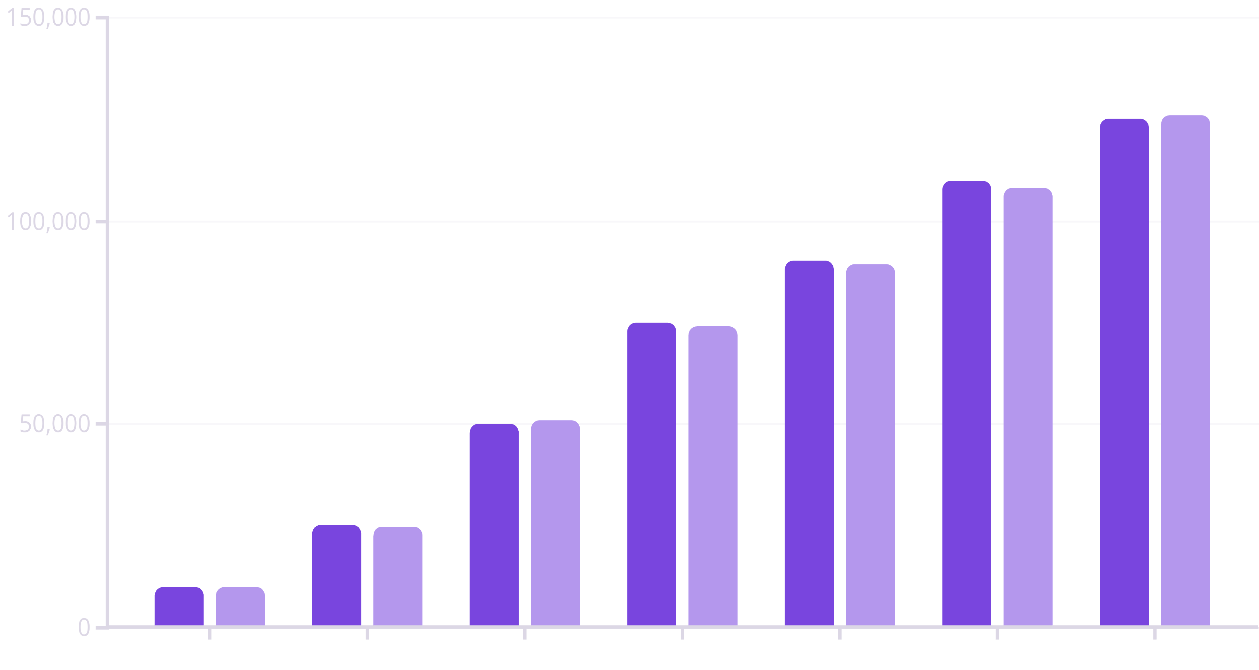
RESULTS & IMPACT
Predicting Emissions for Informed Policy
Our model demonstrates strong predictive capabilities, with a low Mean Absolute Error (MAE) and a high R² Score, indicating a strong correlation between actual and predicted CO₂ emissions. This accuracy provides a reliable tool for strategic climate planning.
Actual CO2 Emissions (kt)
Predicted CO2 Emissions (kt)
The chart illustrates a close alignment between our model's predictions and actual CO₂ emissions, underscoring its potential for practical application.

Slide 5

ETHICAL CONSIDERATIONS & NEXT STEPS
Building Responsible AI for Global Good
As we develop AI for sustainable development, ethical considerations are paramount. We must ensure our models are fair, transparent, and do not perpetuate existing biases, especially concerning data from developing nations.
1
2
3
Data Bias
Fairness
Transparency
Address potential inaccuracies or incompleteness in data, particularly from diverse regions, to ensure equitable representation.
Ensure model predictions lead to just and equitable climate policies that benefit all communities, without disproportionate impacts.
Make model workings and assumptions clear to policymakers and stakeholders to build trust and facilitate informed decision-making.
Our next steps include integrating real-time data, exploring advanced deep learning techniques, and developing interactive dashboards for direct use by climate action leaders.

